Slide 1
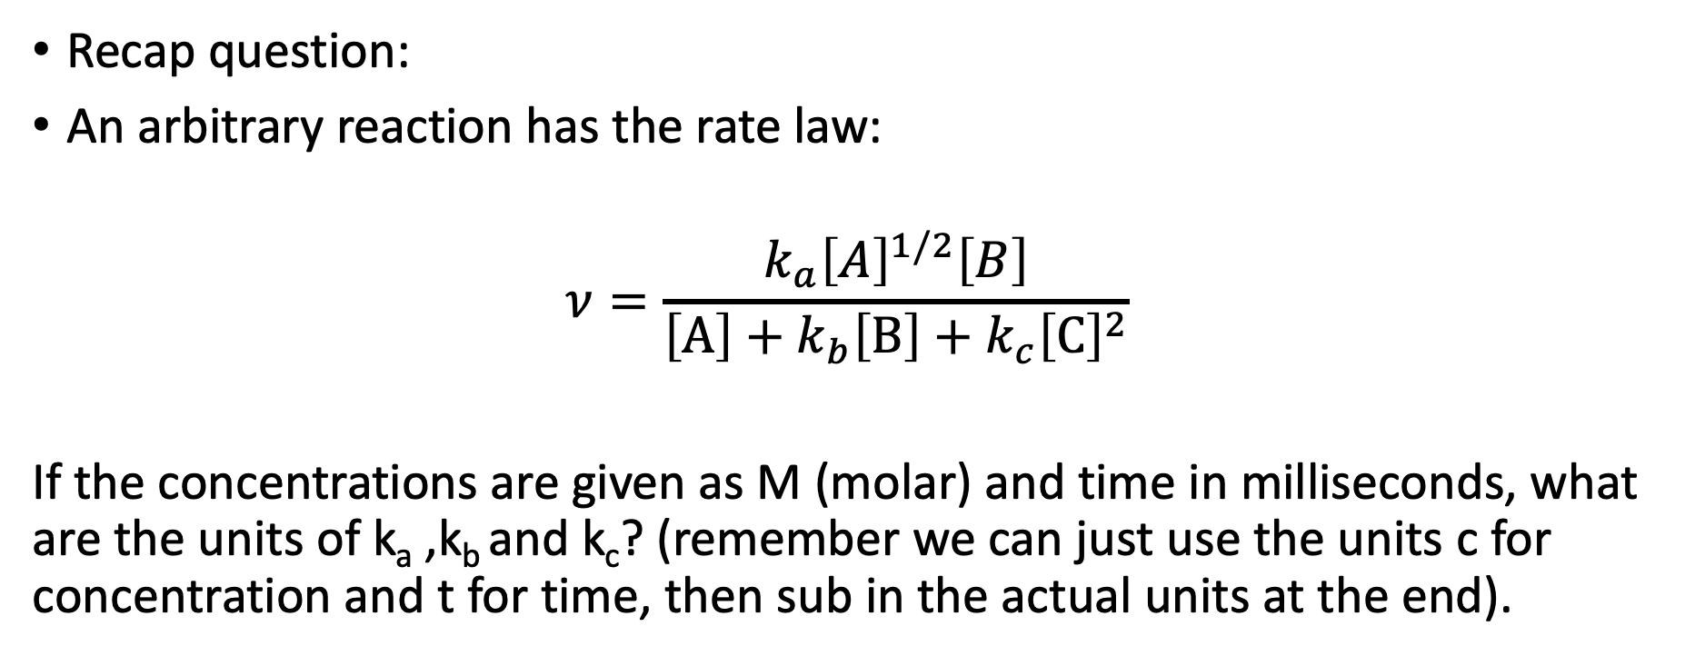
Workshop 3
Recap question:
An arbitrary reaction has the rate law:
$$ν=\frac{k_{a}{\left[A\right]}^{1/2}\left[B\right]}{\left[\text{A}\right]+k_{b}\left[\text{B}\right]+k_{c}{\left[\text{C}\right]}^{2}}$$
If the concentrations are given as M (molar) and time in milliseconds, what are the units of k_{a} ,k_{b} and k_{c}? (remember we can just use the units c for concentration and t for time, then sub in the actual units at the end).

Slide 2
A reaction producing species C₂ from reactant A proceeds according to the radical mechanism outlined below:
A+M → Bᐧ+M rate constant k₁
Bᐧ+A → Cᐧ rate constant k₂
Cᐧ +M → Bᐧ+A rate constant k₃
Cᐧ+ Cᐧ →C₂ rate constant k₄
Identify the initiation, propagation and termination reactions
Identify the chain carriers
Write down the rate equations for each reaction
Write down an expression for the rate of formation of products in terms of the reactants

Slide 3
Perhaps the most well-known chain reaction is the breakdown of the ozone by CFCs. The mechanism by which this proceeds is given by:
C_{n}F_{m}Cl + hν → ᐧC_{n}F_{m} + ᐧCl rate constant k₁
ᐧCl + O₃ → ᐧClO + O₂ rate constant k₂
ᐧClO + O → ᐧCl + O₂ rate constant k₃
ᐧCl + CH₄ →ᐧCH₃+HCl rate constant k₄
Identify the initiation, propagation and termination reactions
Identify the chain carriers
Write down the rate equations for each reaction
Write down an expression for the rate of decomposition of O₃ in terms of the reactants

